Slide 1



Moonly Article’s
KELOMPOK 6
Hafizh zaldy Alviansyah
Muhartsal Raihan

Slide 2


INTRODUCTION
Moonly Article’s is a blog article that provides various kinds of articles, this website purpose to add insight, increase literacy, and entertainment for web visitors. We create a website with a simple and attractive design, making it easier for visitors to access it easily with the various features we provide such as search, popular posts, recent posts, old posts, and contact us.

Slide 3
System Summary
Moonly article is an article website that contains news and information about technology that will continue to be updated from time to time.This Moonly article website is intended to be read by the general public, especially users who want information about technological developments.In making the moonly article using HTML5 functions to describe each page.To improve page views, Moononly articles use 'cascading stylesheets' and 'javascript' from Bootstrap 5 which have class functions that can be used instantly to make it easier for users to beautify their website pages.Moonly's article also uses Jquery javascript so that the website can run and function properly.With the Jquery function in Moonly Article, users can use the quick search function in the top navigation to be able to find the posts they want.

Slide 4

-bootstrap function is to assist users in improving the appearance of an html website with cascading stylesheets that have been provided by bootstrap
-users can use bootstrap by entering class functions that have been provided by bootstrap.
-To see what classes can be entered, users can read the guide on the bootstrap website
Boostrap function
JQuery function
-to make it easier for developers to use and implement JavaScript on websites
-compress various lines or lines of code into one function so you don't have to rewrite all lines of code just to complete one task.

Slide 5

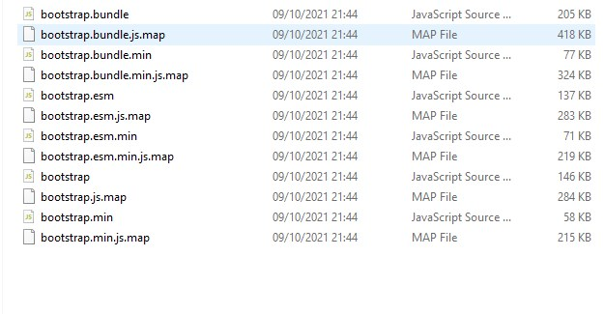
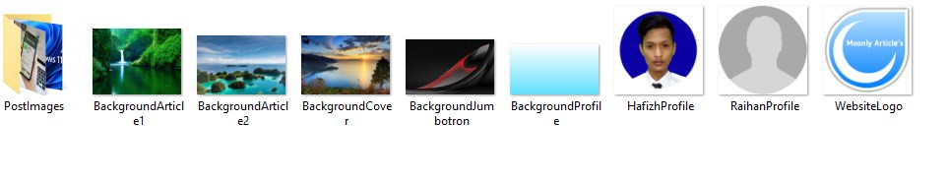
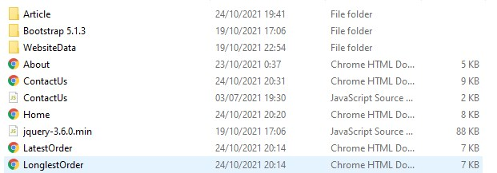
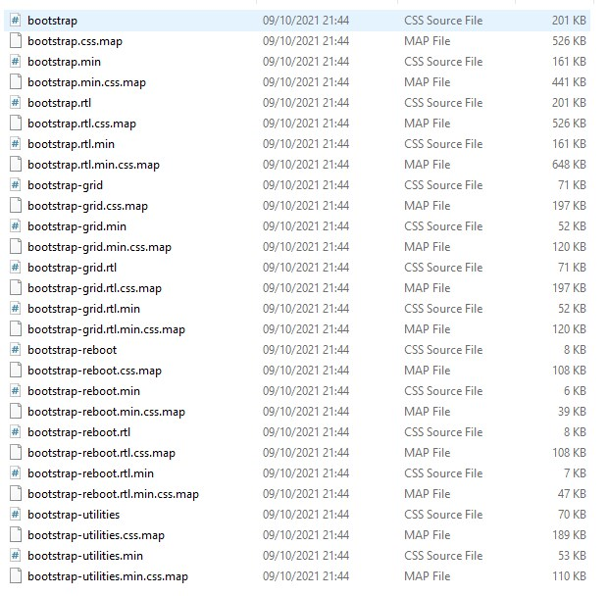
Component
Pictures
Boostrap JS
File
Boostrap CSS

Slide 6
IMPLEMENTATION
Home.html

Slide 7
IMPLEMENTATION
LatestOrder.html

Slide 8
IMPLEMENTATION
LongestOrder.html

Slide 9
IMPLEMENTATION
AboutUs.html

Slide 10
IMPLEMENTATION
ContactUs.html

Slide 11
IMPLEMENTATION
ContactUs.JS

Slide 12
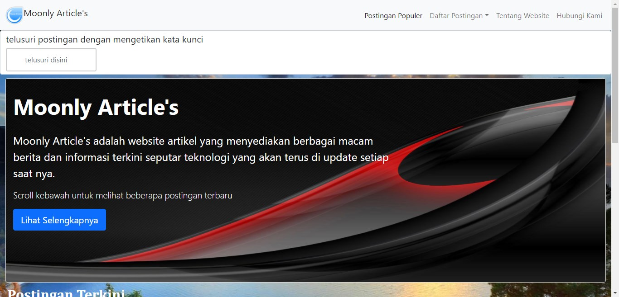
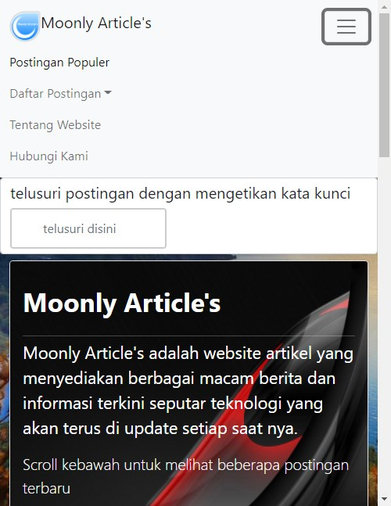
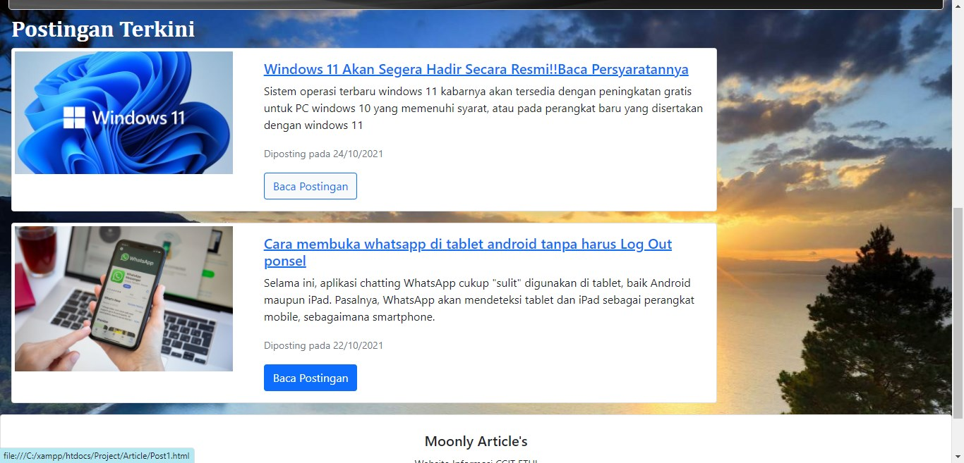
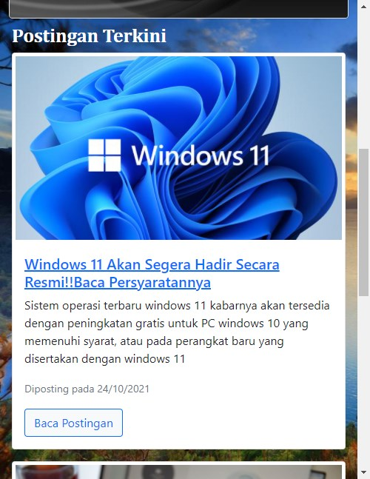
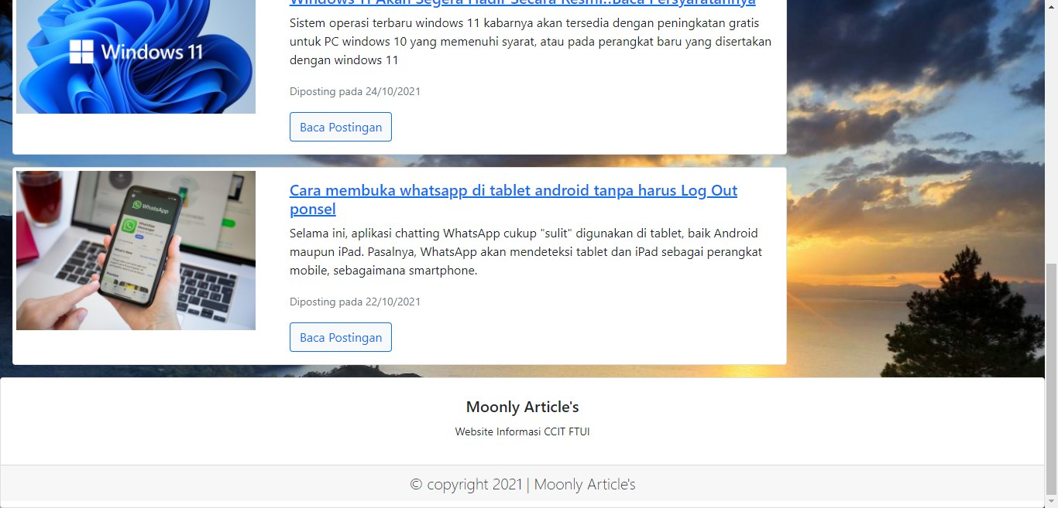
PREVIEW
Home
Mobile

Slide 13
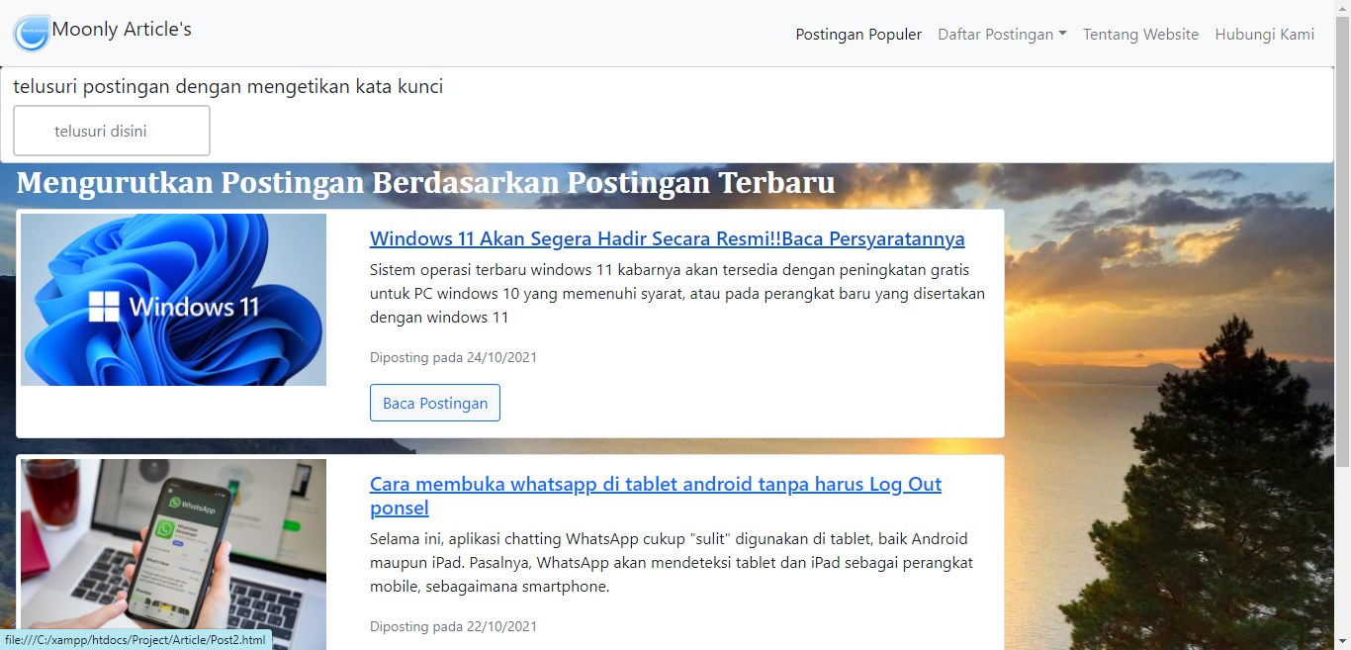
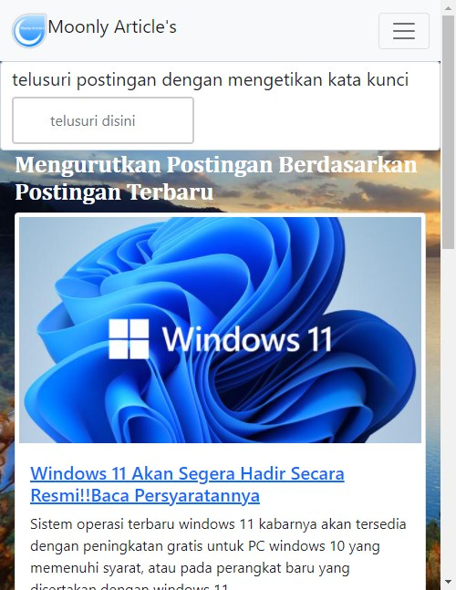
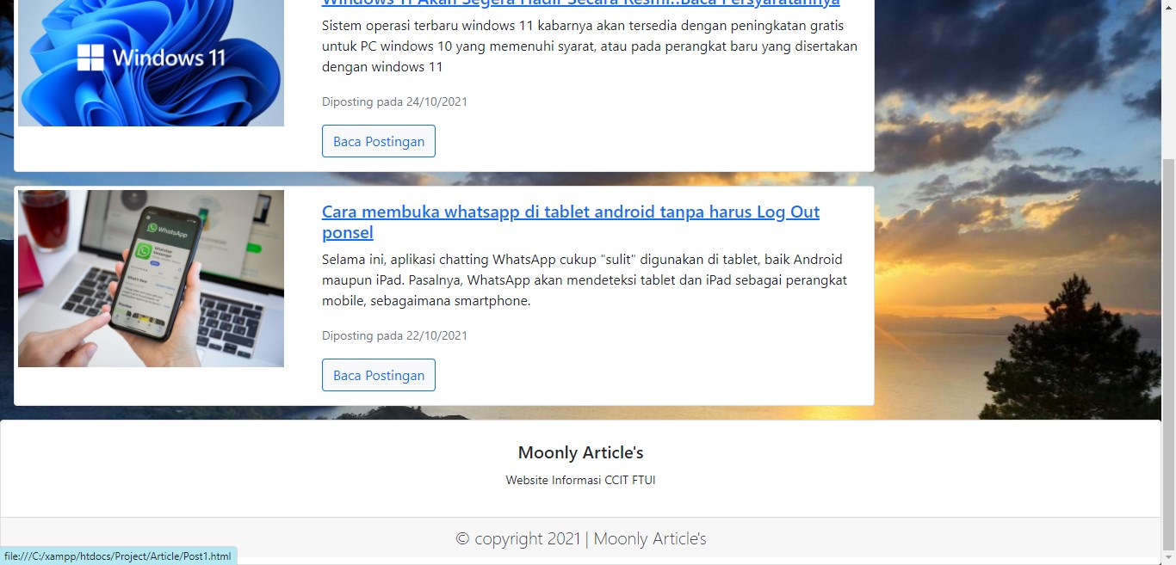
PREVIEW
Lastorder
Mobile

Slide 14
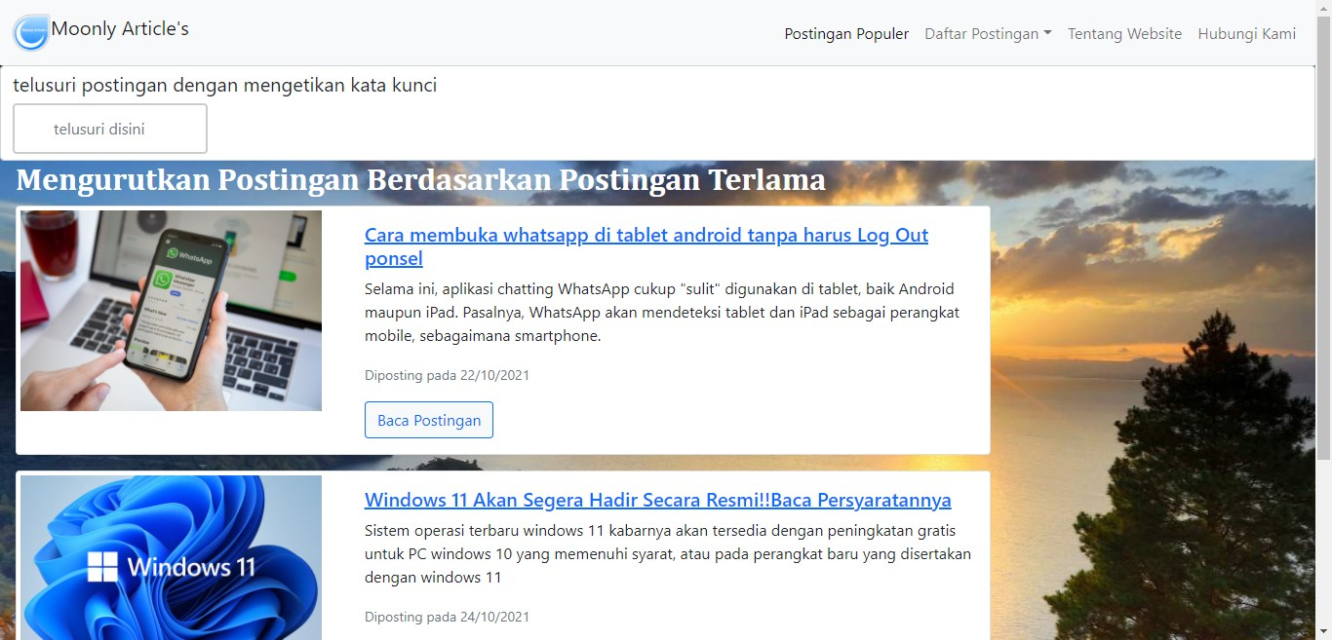
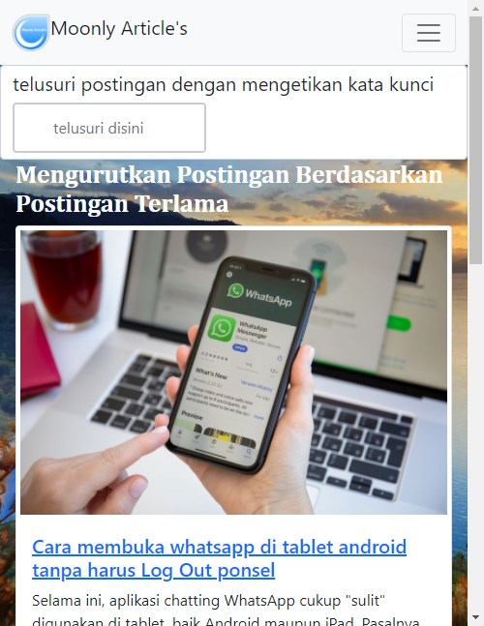
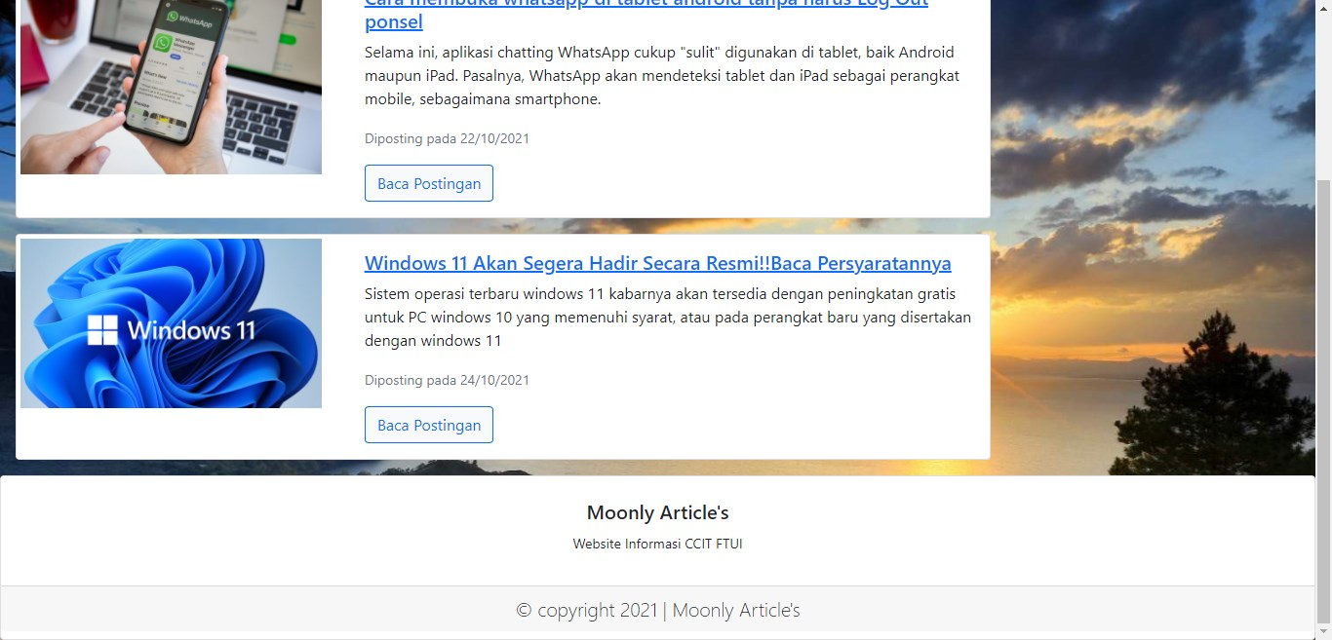
PREVIEW
LongestOrder
Mobile

Slide 15
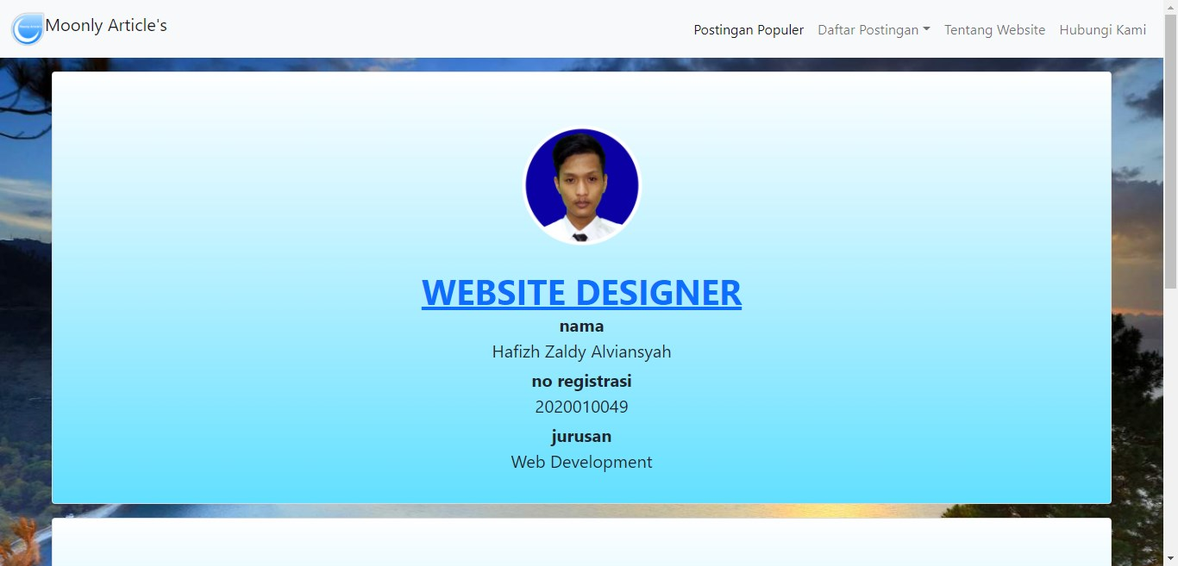
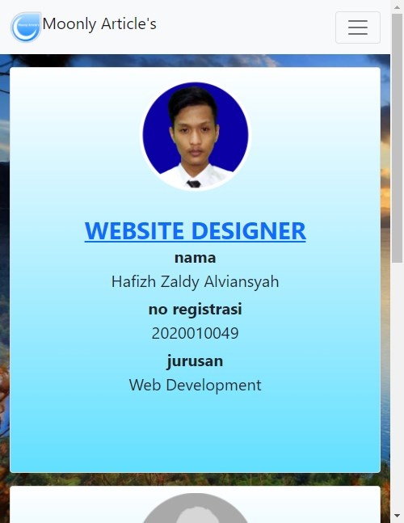
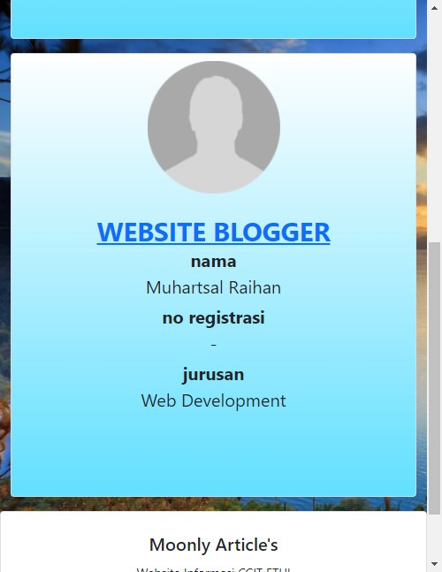
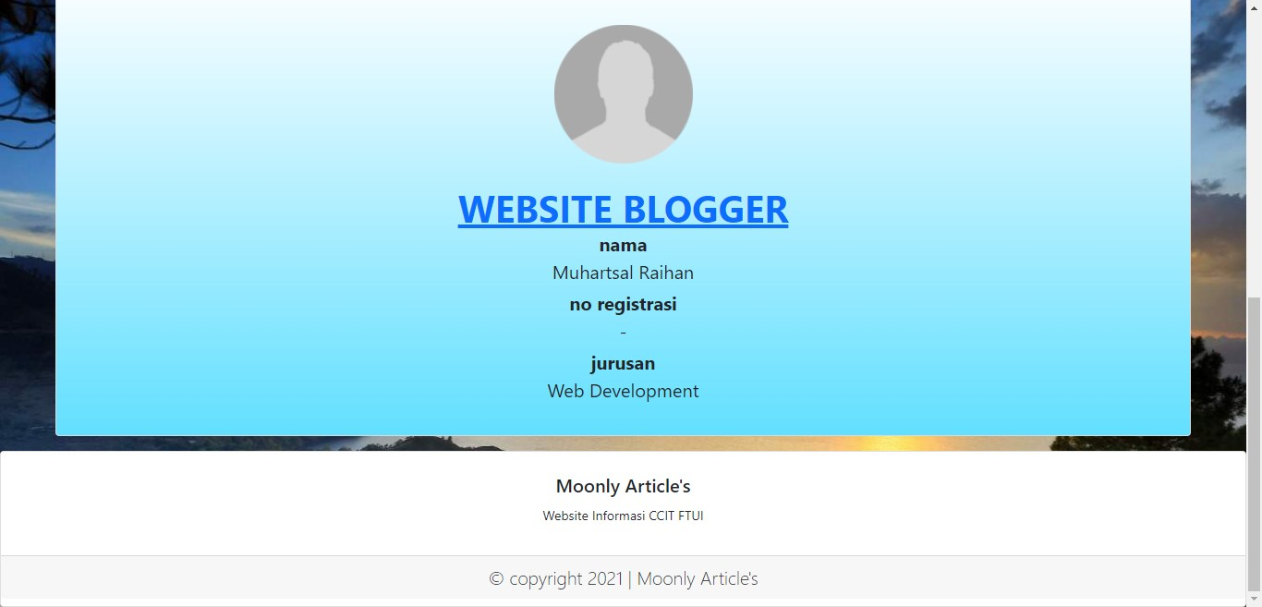
PREVIEW
AboutUs
Mobile

Slide 16
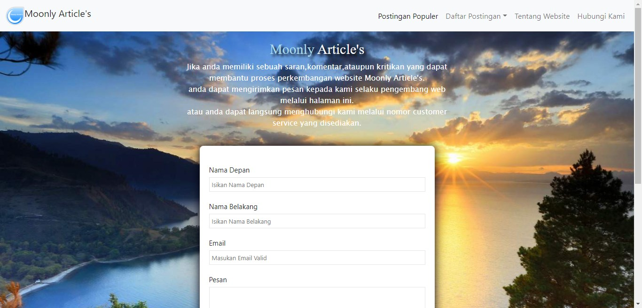
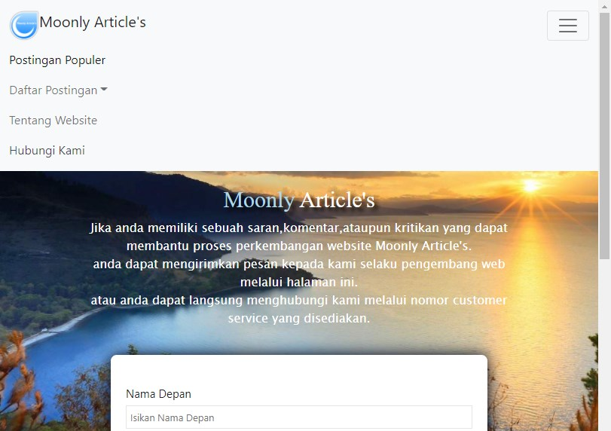
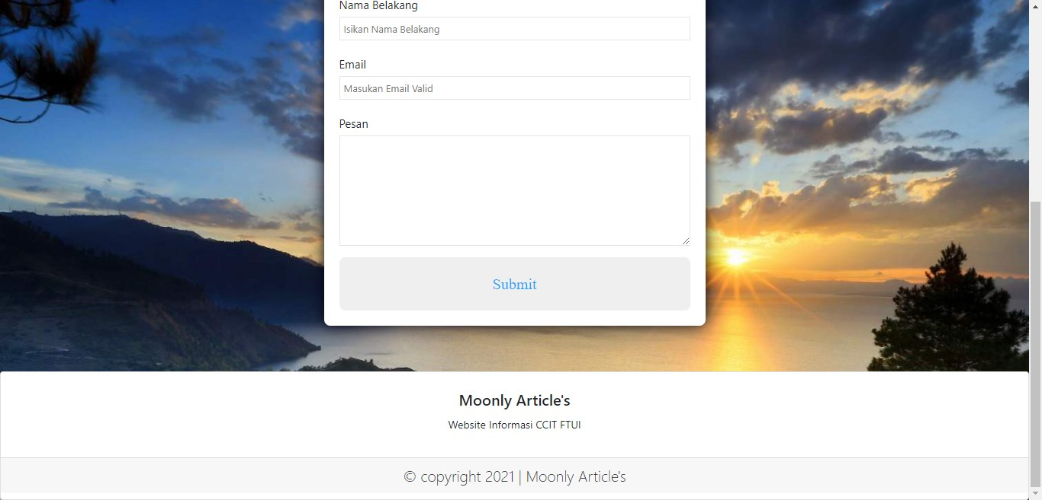
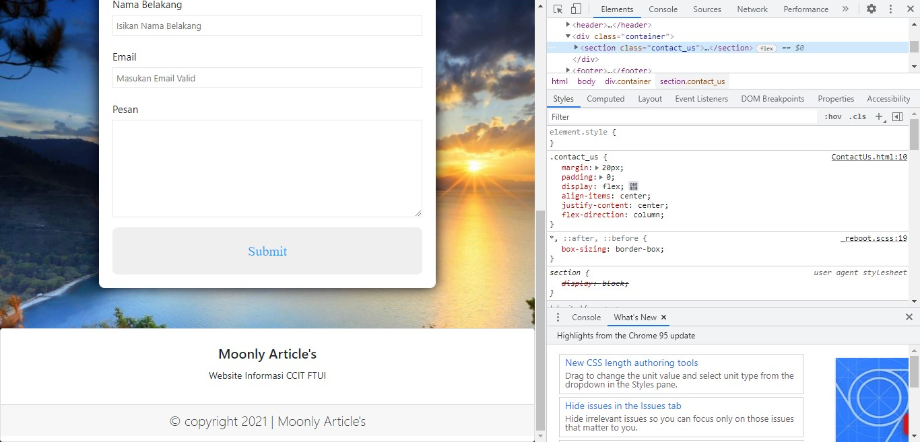
PREVIEW
ContactUs
Mobile

Slide 17
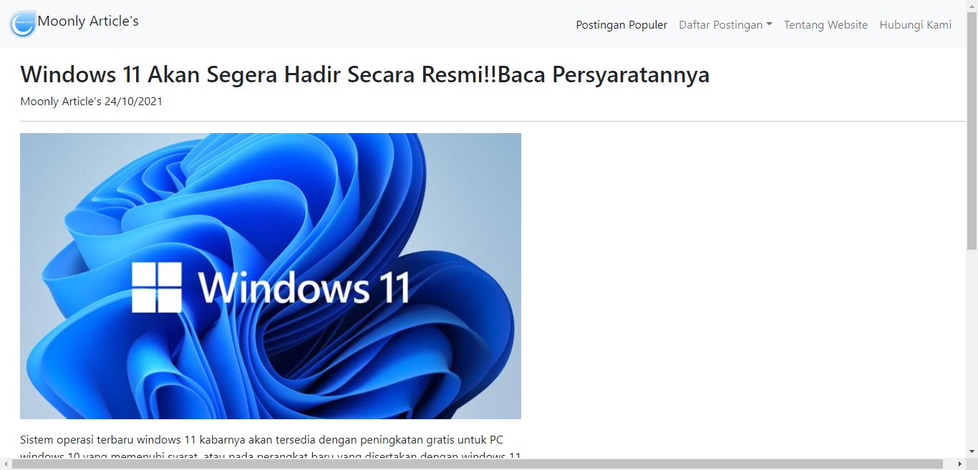
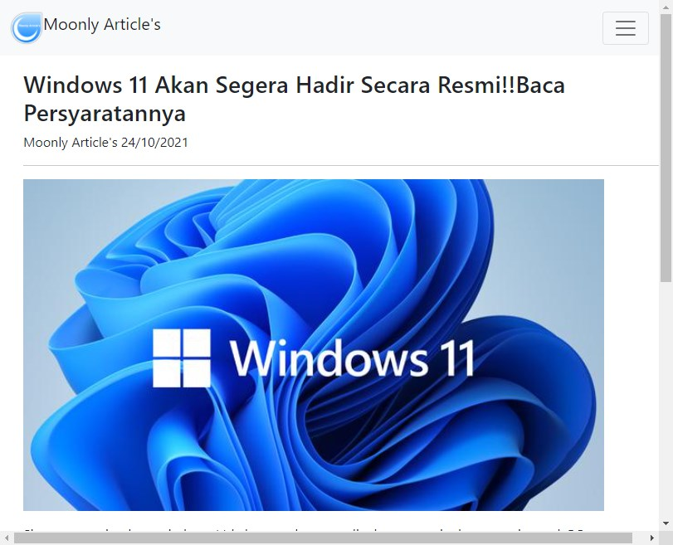
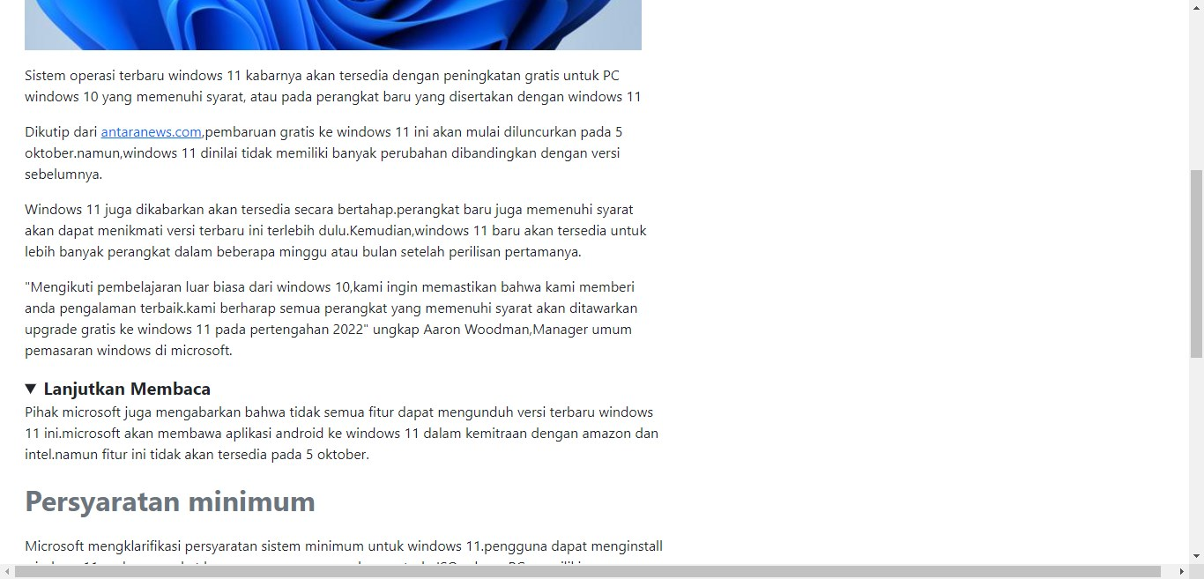
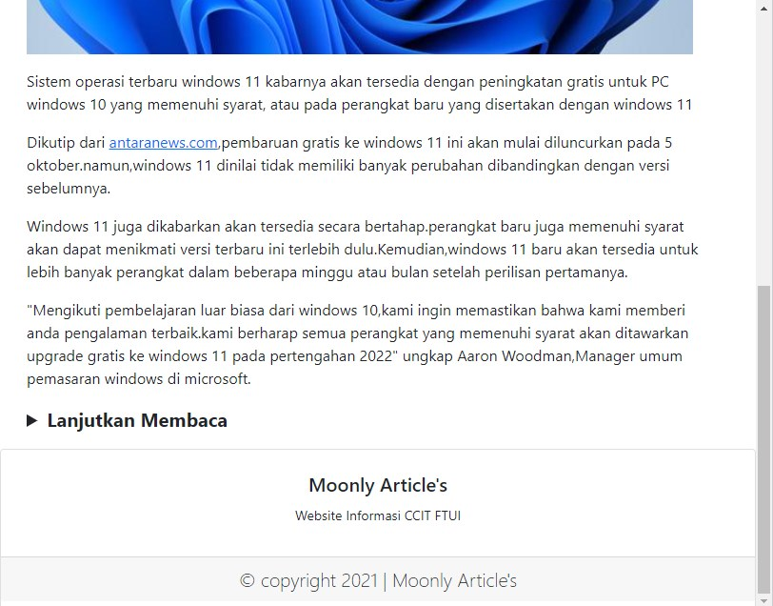
PREVIEW
Article
Mobile

Slide 18
THANKYOU

